Slide 1
ESPOL POLYTECHNIC UNIVERSITY
DEPARTMENT OF
MARITIME ENGINEERING AND SCIENCES
THE WORLD SEABORNE TRADE AND TRANSPORT
FACTS AND CHALLENGES
By: Hugo Tobar Vega
Doctor in Engineering MIT
Professor DMES
August 2010
Guayaquil - Ecuador

Slide 2
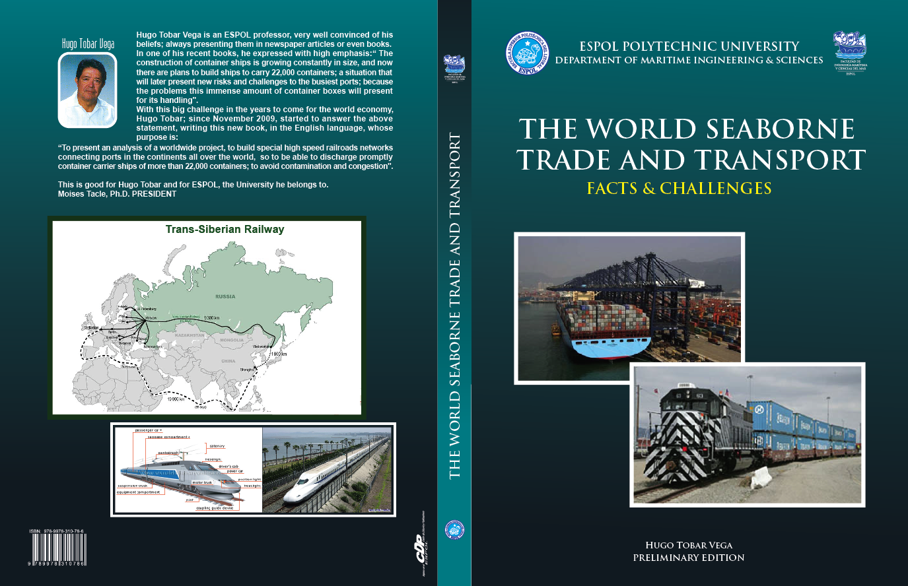

Slide 3
Preface
In May 2009, was presented the book “INTERNATIONAL MARITIME TRANSPORT” . In the preface of this book the following statement is defined:
As time goes by, the construction of container ships is growing constantly in size, there are ships built with a capacity of more of 15,200 container units known as TEUs; and for the year 2010, there are plans to build ships to carry 22,000 containers; a situation that will later present new risks and challenges to the busiest ports, and especially the way the tremendous amount of container boxes will present to its load and unload.

Slide 4
Preface
This particular situation brings the need to think in a new an innovative solution, these are the facts:
The projected 22,000 container ship, will have the following characteristics:
Length: 450 meters
Draft: 27 meters
Speed: 25 knots
This for certain coming situation, calls for an intelligent response because, the world have to answer two fundamental questions:
1. HOW MANY PORTS ON THE FIVE CONTINENTS WILL BE ABLE TO BERTH THIS GIANT?
2. HOW DO WE DISCHARGE AND CHARGE THIS VESSEL WITH THIS AMOUNT OF CONTAINER BOXES TO AND FROM THE PRODUCTION AND CONSUMPTION CENTERS?

Slide 5
Preface
Finally, if in the year 2010, there is a project of a 22,000 containers ship, for the year 2050 we have these other questions:
HOW BIG WILL THE BIGGEST CONTAINER SHIP BE?
2. HOW WILL THIS SHIP PROPULSION SYSTEM BE?
3. IF FOR THE YEAR 2050, THE OIL AND ALL THE FOSSIL FUELS WILL BE COMPLETELY DEPLETED ALL OVER THE WORLD; HOW WE ARE GOING TO PROPEL THESE BIG VESSELS?

Slide 6
Preface
This book is integrated by four parts, as follows
Part I: The World Seaborne Trade System
Part II: The World Seaborne Shipping System
Part III: Facts and Challenges
Part IV: Special Cases and Findings

Slide 7
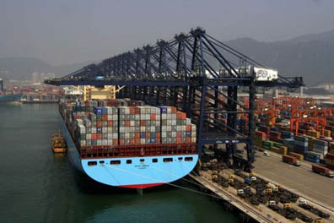
FRONT COVER
Emma Maersk

Slide 8
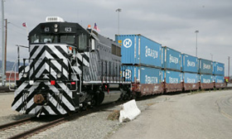
FRONT COVER
The New Diesel Engine Locomotive

Slide 9
BACK COVER

Slide 10
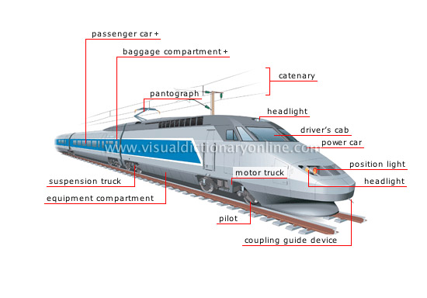
BACK COVER
High Speed Train Details

Slide 11
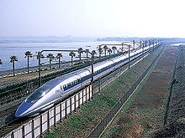
BACK COVER
Shinkansen High Speed Train

Slide 12
Part I
THE WORLD SEABORNE
TRADE SYSTEM

Slide 13
Maritime transport is divided into three cargo groups:
The liquid bulk cargo, for the transport of crude oil its products and other liquids.
The solid bulk cargo, for the transport of minerals and especially those the world most needs, wheat and other grains; essential to feed the whole humanity.
And the third group is the general cargo, consisting of manufactured products that until the 1960s, were transported loose in the holds of ships; when a wise shipping business executive, generalized the construction and the use of ships built with modular holds to accommodate the containers boxes transported by trucks on the United State of America highways

Slide 14
TYPE OF CARGO
(Millions of Metric Tons)
Source: UNCTAD

Slide 15
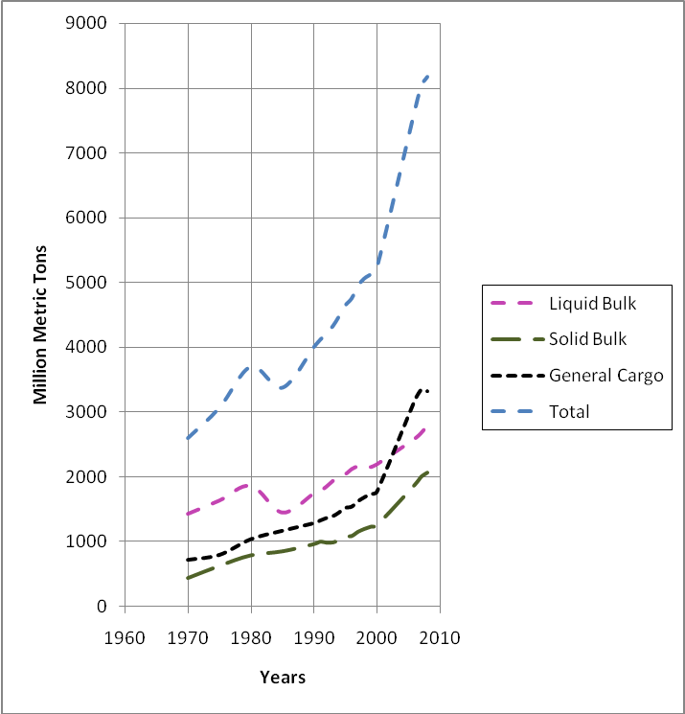
INTERNATIONAL WORLD TRADE

Slide 16
INTERNATIONAL SEABORNE TRADE TYPE OF PRODUCT
(Million Metric Tons )
Source: Shipping Statistics Yearbook 2009 (€ 1200 subscription cost)

Slide 17
Part II
THE WORLD SHIPPING SYSTEM

Slide 18
COMMERCE AND SHIPPING
The integrated chain of transport has been applied to the international transport, whose primary target is to improve and accelerate the product distribution; and optimize the use of the different transport facilities, reducing the accumulation of cargo inventories.
But most important reduce the number of inactive facilities and vehicles such as: ships, trucks and railroads by delays at ports; therefore this chain integrated this way is called:
INTERMODALISM OR MULTIMODALISM

Slide 19
Ship Class Economy
This specialization, generated by the economic aspect, has meant an increase in the size of ships, with a denomination called Worldscale , which is determined by a reason and an index. The Table below, shows this system for the transport of crude oil; there are also scales for other types of transport.

Slide 20
CHARACTERISTICS OF THE WORLD CONTAINER FLEET
As January 2010
Source: The Containership Register

Slide 21
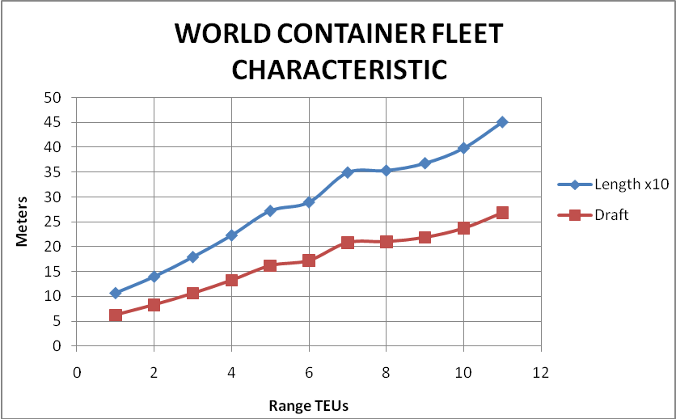

Slide 22
CHRONOLOGICAL CHARACTERISTICS INCREASE
BIGGEST CONTAINER SHIP
Range
Class (TEUs )
Capacity
Year
Draft
TEUs
TEUs
Construction
Meters
1
Feeder (100-499)
322
1960
6,24
2
Feedmax (500-999)
735
1966
8,29
3
Handy (1.000-1.999)
1405
1968
10,60
4
Sub Panamax (2.000-2.999)
2254
1969
13,23
5
Panamax (3.000 +)
3075
1985
16,16
6
Post Panamax (4,000 +)
4625
1988
17,20
7
Post Panamax Plus1 (5,000 +)
5225
1995
17,58
8
Post Panamax Pus 2 (6,000 +)
6375
1996
18,13
9
Post Panamax Pus 3 (7,000 +)
7250
1997
18,92
10
Post Panamax Pus 4 (8,000 +)
8050
2001
19,50
11
P. Pan Plus 5 (Clement Maersk)
9600
2002
20,80
12
P. Pan Plus 5 (Axel Maersk)
9310
2003
20,99
13
Suez Max (Gudrum Maersk)
10150
2005
21,86
14
Post Suez Max (Emma Maersk)
15200
2006
23,70
15
Corea STX
22000
2012
26,79

Slide 23
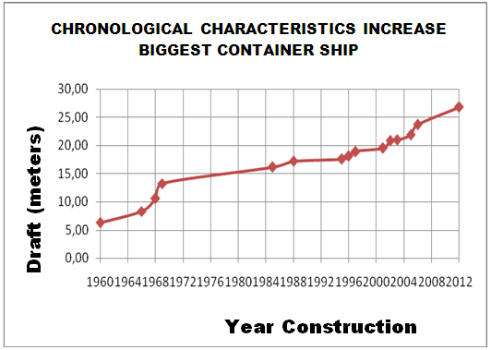

Slide 24
From the data shown on the table above, during the period of 52 years from 1960 to 2012, the following facts are produced:
The maximum draft of the biggest container carrier ship built, increases from 6.24 to 26.79 meters, at a rate of 0.40 meters per year.
The maximum capacity of the biggest container ship built, increases from 322 to 22,000 containers, a rate of 417 per year.
These findings give us a real indication of what the world can expect for the main question presented in this book of:
WHAT DO WE EXPECT FOR THE YEAR 2050 OF THE WORLD SHIPPING SYSTEM?.

Slide 25
Design Parameters of Largest Container Ships
Design Parameters Malacca-max; Suez-max; Sovereign Maersk
Length (m) 400.00 400.00 348.00
Breadth (m) 60.00 50.00 42.80
Draft (m) 21.00 17.04 14.00
Depth (m) 35.00 30.00 24.10
Displacement (tons) 313,371 212,194 142,500
Deadweight (tons) 243,600 157,935 105,000
TEU capacity 18,154 11,989 8,400
Service speed (kn) 25.00 25.00 25.00
Engine power (kW) 116,588 91,537 61,000

Slide 26
PROPULSION TRENDS IN BIG CONTAINER CARRIERS
Container ships of up to 22,000 Teu, may be expected in the future as soon as 2012. For such very large vessels , the propulsion requirement may be up 100 MW/136,000 Brake Horse Power (bhp), when operating at 25 knots.
Single-screw vessels are the cheapest and most efficient solution compared with a twin screw solution.
A great deal of analysis has been made, dealing with container vessels built over the last five years, in particular using the latest MAN B&W two-stroke engine.

Slide 27
The Actual Biggest Container Ship Propulsion System
The Emma Maersk transports containers across the Pacific Ocean in only five days, at a cruise speed of 31 knots.
This vessel is strictly for the Trans Pacific service, from China to California.
Was built in five sections, the navigation bridge is higher than a 10-story building and has 11 cargo crane rigs that can operate at the same time.
Length: 397 meters; Draft: 23.7 meters
Cargo capacity: 123,200 tons, 15,200 Teu
Propulsion: 14 cylinders in line diesel engine, 110,000 BHP
Crew: 13 people
Construction cost: US$145´000,000
First trip: September 8, 2006

Slide 28
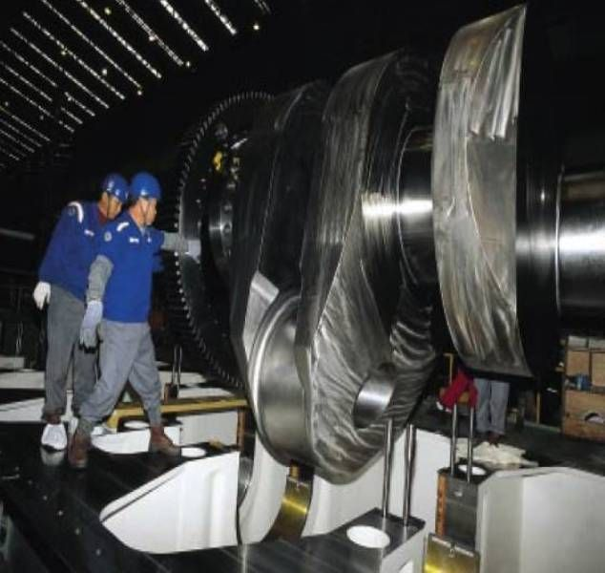
Emma Maersk Crankshaft and Operators

Slide 29
Nuclear Power the Future Propulsion System
Nuclear power has been used for propulsion in submarines and aircraft carriers. For submarines to attain a great fuel autonomy (even years) and for aircraft carriers, because fossil fuels engines were too big and cumbersome.
On December 2009, the President of the Chinese shipping line COSCO, presented a proposal to use nuclear power onboard merchant ships. In this occasion he said:
“The decision to push ahead with super slow steaming, was in part environmental; using nuclear power onboard merchant ships is a further green initiative. As they are already onboard submarines, why not cargo ships?”
COSCO is in talks with the Chinese national nuclear authorities, about this new idea.

Slide 30
Characteristic & Conditions
Initial costs are six times higher ($900 million versus 150 million)
Three nuclear ships could do the work of 4 regular ships and operational costs would be lower.
A reasonable timeline for nuclear commercial shipping is in the 10-15 year timeframe (2020?). The characteristics of this vessel are:
Capacity 15,000 TEU (like the Emma Maersk)
Length: 405 m ;Beam: 60 m ;Draft: 15.5 m
Speed: 32 knots; Power: 150 Mw (200,000 SHP); Propellers: 2
Economic Findings
1. Assumes Nuclear @ $2500 / kW
2. Assumes Diesel @ $800 / kW
3. Assumes Plant Life 40 Years
4. Assumes Interest Rate 10%
Special Condition This propulsion system is possible only for ships of about 10,000 Teus and up, because the size limitations of a nuclear power plant.

Slide 31
PORT INTERMODAL RAIL TRANSPORT
Intermodal freight transport, involves the transportation of freight in an intermodal container or vehicle, using multiple modes of transportation (rail, ship, and truck); without any handling of the freight itself when changing modes. This method reduces: cargo handling, damages, losses; and freight is transported faster.
Reduced costs versus over road trucking are the key benefit for intercontinental use.
In the U.S. such containers, known as "lift vans”, were in use from as early as 1911. Later these vans transported by trucks on highways, adopted the 8x81/2x 20 measurements; and were directly put aboard especially built ships to transport merchandizes all over the oceans of the world.

Slide 32
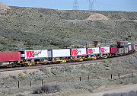
The illustration that follows, show an intermodal train carrying both shipping containers and highway semi-trailers.

Slide 33
Intermodal Railroad Networks
The Trans Siberian Railway System
This is the most extensive and important intermodal railroad network in the world. The illustration of this network considered one of the marvels of the world, has been the inspiration to realize this investigation and analysis of this work; “to use high speed trains for the intermodal transportation on land, the immense quantities of containers carried these days by very big container carrier ships and of the future”.
The Trans-Siberian is a major freight artery offering a fully developed container service across Eurasia from Berlin to Beijing, with links to major cities in Europe, including Helsinki, Kaliningrad, Warsaw, Minsk, Kiev, St-Petersburg, Smolensk and Yekaterinburg. And in addition to Russian stations in Siberia itself, the Trans-Sib also has connections to Astana in Kazakhstan, Ulaanbaatar in Mongolia, Beijing in China, Pyongyang in North Korea and Seoul and Pusan in South Korea.
To attract freight to the Trans-Siberian route the International Coordinating Council on Trans-Siberian Transportation was formed.

Slide 36
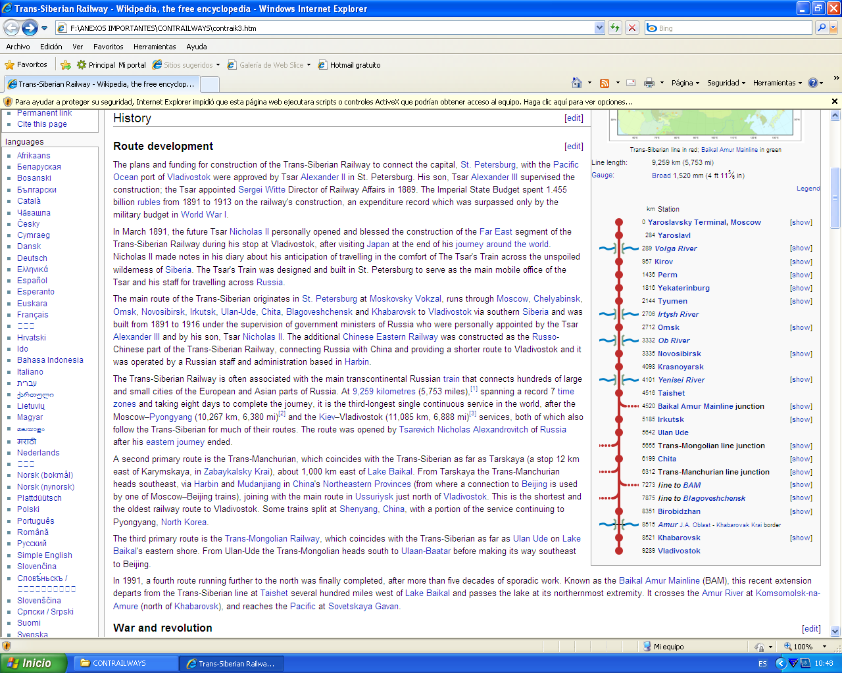
Stations Along The Trans-Siberian Railroad Network

Slide 37
Trans-Siberian Railroads Networks Operators
China Shipping Container Lines
ZHL Trans Professional
NWS Holdings
Trans Container and China Railway Container Transport

Slide 38
Conclusions
From the start the Siberian transit transport route was intended in addition to Russia own transport needs, for goods traffic between West Europe and Japan. Since then, connections have been made with Hong Kong and the Philippines. In the future connections via Siberia may be made with Taiwan, South Korea and other East Asian countries and Australia. Thus the international significance of the Trans-Siberian railway in trade between the Far East and Europe will increase considerably.
WITH THE INCREASE IN SIZES OF CONTAINER SHIPS, THIS RAILROAD NETWORK WILL BE THE MOST IMPORTANT ROAD OF MULTIMODAL TRANSPORT FROM THE HIGH PRODUCTIVE ASIAN NATIONS TO: ALL EUROPE, THE MIDDLE EAST AND THE SOUTH ASIAN COUNTRIES.

Slide 39
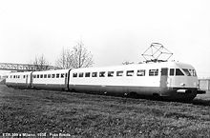
HIGH SPEED RAILROAD SYSTEMS
The Italian ETR 200 in 1939, was the first high speed service train. It achieved the world mean speed record in 1939 of 203 kilometers per hour (km/h) near Milan in Italy. The picture that follow show this train traveling with passengers approaching Milan.

Slide 40
Definition of High Speed Trains
There are a number of different definitions for high-speed rail, and there is no single standard.
European Community Directive 96/58, defines high-speed rail as systems of rolling stock and infrastructure which regularly operate at or above 250 km/h on new tracks, or 200 km/h on existing tracks.
In the United States high-speed rail is defined as having a speed above 110 mph (180 km/h) by the United States Federal Railroad Administration
In Japan high speed Shinkansen lines use standard gauge track rather than narrow gauge track used on other Japanese lines. These travel at speeds in excess of 260 km/h without at-grade crossings.
In China there are two grades of high speed lines. Firstly slower lines that run at speeds of between 200 and 250 km/h and have freight as well as passenger trains. Secondly, passenger dedicated high speed rail lines operate at top speeds of up to 350 km/h.

Slide 41
Power Source
Travel by rail becomes more competitive in areas of higher population density or where gasoline is expensive, because conventional trains are more fuel efficient than cars and other forms of mass transit. Very few high-speed trains consume diesel or other fossil fuels but the power stations that provide electric trains with power can consume fossil fuels, or use nuclear plants.
In Japan and France, where the most extensive high speed rail networks exist, a large proportion of electricity comes from nuclear power. Even using electricity generated from coal or oil, trains are more fuel efficient than the typical automobile because of economies of scale in generator technology.

Slide 42
Technology and Costs
France's TGV technology has been adapted for use in a number of different countries.
Much of the technology behind high-speed rail is an improved application of mature standard gauge rail technology using overhead electrification. By building a new rail infrastructure with 20th century engineering, including elimination of constrictions such as roadway at-grade (level) crossings, frequent stops, a succession of curves and reverse curves, and not sharing the right-of-way with freight or slower passenger trains, higher speeds (250–320 km/h) are maintained.

Slide 43
Technology and Costs
Total cost of High Speed Rail systems is generally lower than the total costs of competing alternatives (new highway or air capacity). Japanese systems are often more expensive than their counterparts but more comprehensive because they have their own dedicated elevated guide way, no traffic crossings, and disaster monitoring systems. The high Japanese system's cost is related to the boring of tunnels through mountains, as in Taiwan.
Recent advances in wheeled trains in the last few decades have pushed the speed limits past 400 km/h, among the advances being tilting trainsets, aerodynamic designs (to reduce drag, lift, and noise), air brakes, regenerative braking, stronger engines, dynamic weight shifting, etc..

Slide 44
Magnetic Levitation
Maglev, or magnetic levitation, is a system that suspends guides and propels trains, using magnetic levitation from a very large number of magnets for lift and propulsion. This method has the potential to be faster, quieter and smoother than wheeled systems. The power needed for levitation is usually not a particularly large percentage of the overall consumption; most of the power used is needed to overcome air drag, as with any other high speed train.
The highest recorded speed of a Maglev train is 581 km/h, achieved in Japan in 2003.
The first commercial Maglev "people-mover" was opened in 1984 in Birmingham, England. It operated between Birmingham Airport and Birmingham Railway Station, running at speeds up to 42 km/h; the system was closed in 1995 due to design problems.

Slide 45
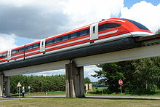
Magnetic Levitation Train in Germany

Slide 46
The Typical High Speed Train
Components

Slide 47
Recent Projects
South Africa
The Gautrain, Africa's first high-speed rail line, was launched on June 8, 2010 in South Africa three days before the opening match of the 2010 football World Cup.
Brazil
The Brazilian government envisages three additional high-speed rail lines as part of the latest set of ambitious infrastructure plans outlined at the end of March 2010 by President Luiz da Silva.
China
On may 2010, the government of China announced that the country is spending mountains of money on “China’s Cut-Throat Railway Revolution” to expand its country's high-speed railway network and manufacture the world's fastest trains.
United States of America
Japan to give loans for US high-speed rail bids was announced on April 27, 2010. Japan will allow state loans for bids to build high-speed train lines in the U.S. to boost the nation’s railroad suppliers as they compete against Chinese and European rivals.

Slide 48
And Finally
After this presentation, I hope that
in the near or distant future; time will
come for high speed intermodal railroad
networks in all the continents of the world, as an answer to the very big nuclear propelled
container ships to come.
This is my wish and hope
Thanks for your time and attention
Hugo Tobar Vega

