Slide 1

THE IMPORTANCE OF ENGLISH IN INTERNATIONAL BUSINESS
By Cindy Mena

Slide 2
OUTLINE
History of English.
English as a Lingua Franca.
International Businesses.
Research Report.

Slide 3
General Objective
Persuading the reader to improve their level of English.
Specific Objective
Inform to the reader about different items which involve the principal topic.

Slide 4
Hypothesis
Demonstrate how important English is in all aspects, but specifically in business.

Slide 5


THE HISTORY OF ENGLISH AS A BUSINESS LANGUAGE

Slide 6
Three Stages:
Old English. (449 – 1100 A.D.)
Middle English (1100 -1500 A.D.)
Modern (1500 – 1660 A.D.)

Slide 7
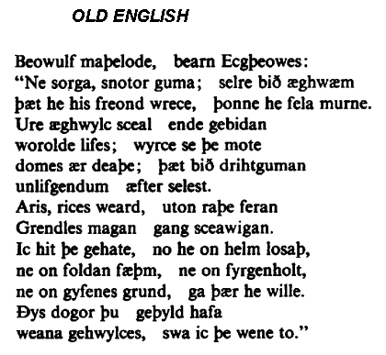
Old English:
Period from 449 – 1100 A.D.
Germanic tribes who invaded England: Angles, Saxons, Jutes, Frisians.
Different origins of the Anglo-Saxon kingdoms of Great Britain.

Slide 8
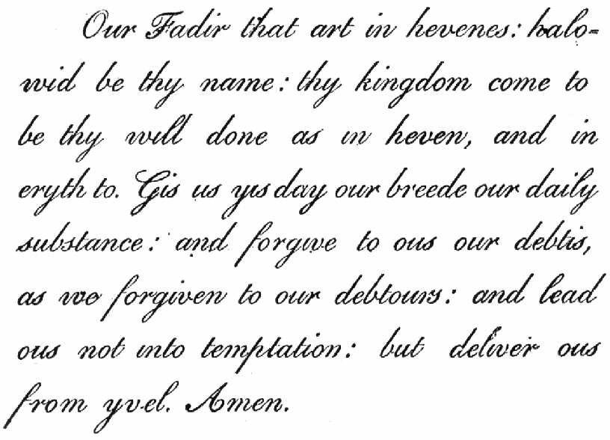
Middle English
Period from 1100 – 1500 A.D.
Norman Conquest .
English grammar, the "continuous" tenses, with the suffix "-ing"

Slide 9

Modern English
Modern English had two stages:
  The Classic
  The contemporary
Around the time of William Shakespeare.

Slide 10

  The Classic:
From 1500 until 1660.
More commonly associated with literary language of William Shakespeare.
Great Vowel Shift.
Printing press.

Slide 11

The Contemporary:
From 1660 until today.
The main difference between Classic and Contemporary Modern English is vocabulary.
Business English.
Notes:
Zoom Out

Slide 12


ENGLISH AS A LINGUA FRANCA IN BUSINESS

Slide 13
ENGLISH AS A LINGUA FRANCA IN BUSINESS
A Lingua Franca, originally Italian for "Frankish language".
Specific English Communications in Business.
English for specific business purposes.

Slide 14

INTERNATIONAL BUSINESSES

Slide 15

INTERNATIONAL BUSINESSES
All commercial transactions that take place between two or more nations.
Globalization.

Slide 16
GLOBALIZATION
Is not a new concept.
The global integration of economies.

Slide 17

The Global Perspective in Business.
Notes:
PONER UNA FIGURA DE MC DONALDS.

Slide 18

RESEARCH REPORT
Notes:
PONER UNA IMAGEN DEL CELEX

Slide 19
RESEARCH REPORT
Objectives:
Establish how important English is for Ecuadorian students.
What are doing Ecuadorian English Institutes for preparing students.
How affect the knowledge of this language in the international business.

Slide 20
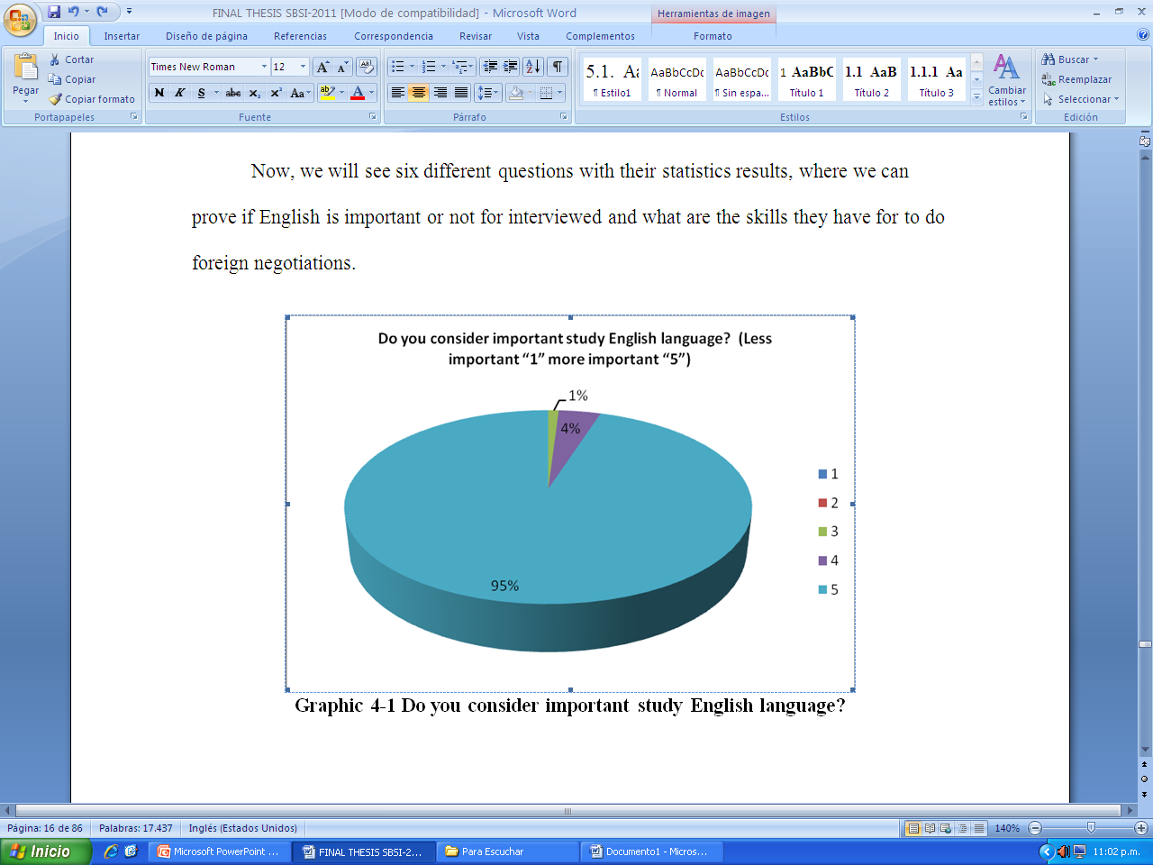
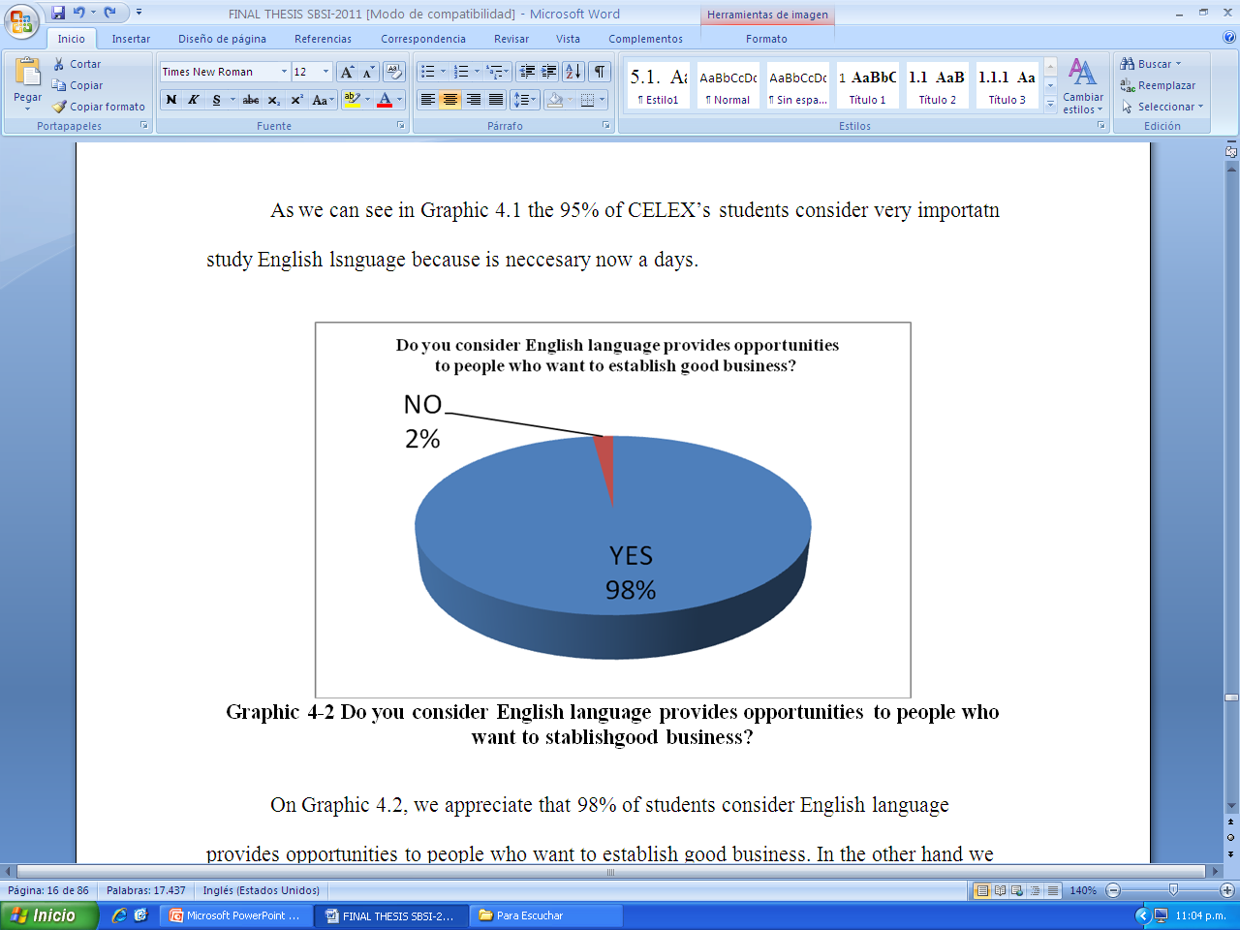
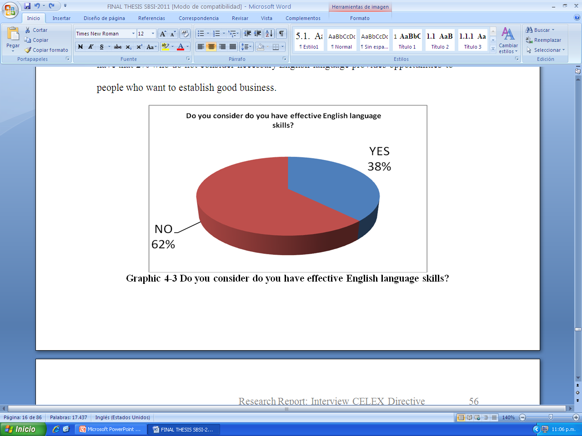

Slide 21
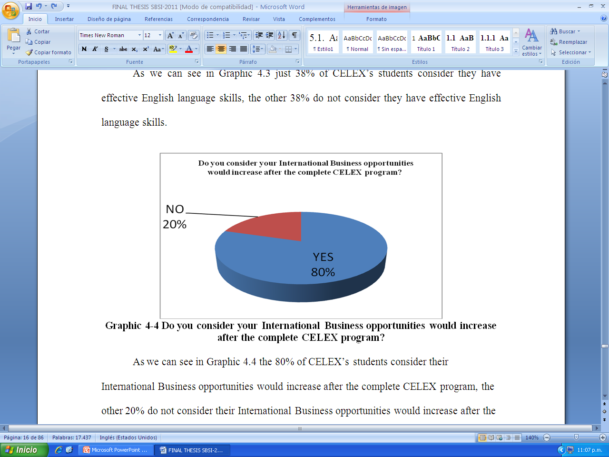
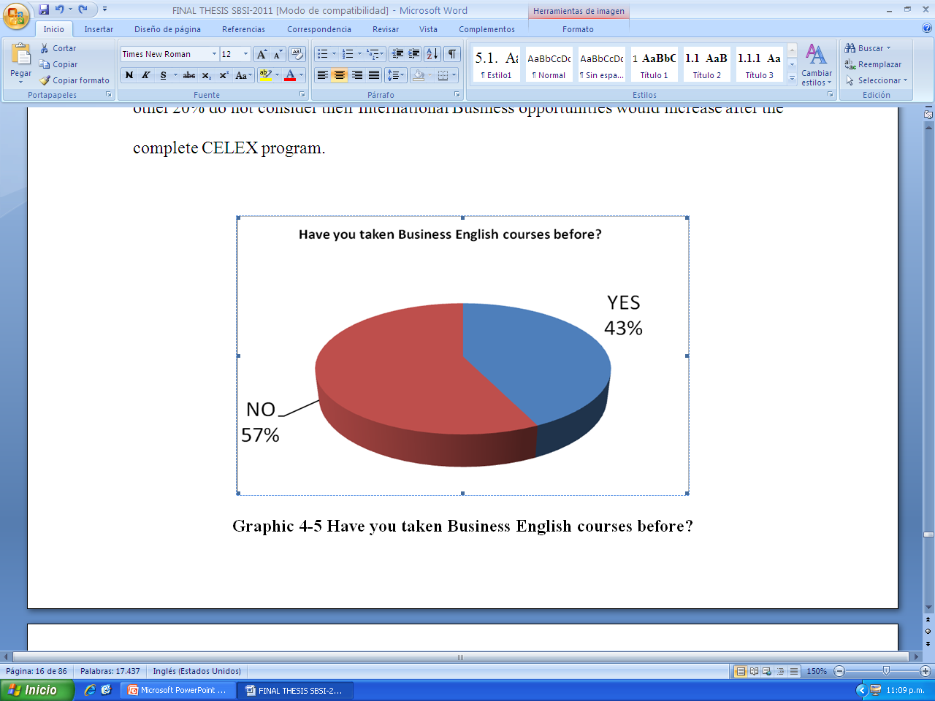

Slide 22

Msc. Emma Pedley’s interview:

Slide 23
Msc. Emma Pedley
Her Globalizations concept is the spreading of an idea, product, or technology around the world, social, economic, industrial. She considers English and Globalization are related in all aspects.

Slide 24
Msc. Emma Pedley
English in International Business, is important know a general English, because when you are traveling you need to be able to communicate in general, on accommodation, on giving directions, giving personal information about yourself or general things.

Slide 25
Msc. Emma Pedley
She agree with it –best is to get everybody to general English level and then they can learn to specialize in their degree or in their areas. If CELEX offer specific classes for everyone, it’s complicated, and really they’re going to be teaching more or less the same.

Slide 26
Conclusion
English is important in all aspects: historical aspect, social aspect, technical aspect, but specifically in business, because we are living in a globalized world where all kinds of negotiation with foreign countries need to have effective English language skills.

Slide 27
THANK YOU!!

