Slide 1

“THE INFLUENCE OF THE TECHNOLOGY IN PUBLIC COMPANIES”
Author: María de los Ángeles Lozano Cedeño
2011

Slide 2
Outline
Technology on your hands
Technology applications
Secretary activities and technology
Internet in the professional field
Research Report in Public Companies

Slide 3
  General objective
  Inform about the importance of technology and motivate to use it.
  Hypothesis
  Technology will bring changes to professionals although they feel afraid.
Methodology
  Exploratory, Inductive and deductive methods were used

Slide 4

Technology on your hands
Importance
Advantages and disadvantages
Kinds of technology
Objective: Establish how much technology is helpful in daily
activities.

Slide 5

Importance of technology
Technology on your hands
Satisfy our needs
Work with facilities
Improve communications
Automate processes
Maximize efficiency

Slide 6

Advantages and disadvantages
Technology on your hands
Access to information
Methods and processes on business
Efficacy on processes

Slide 7
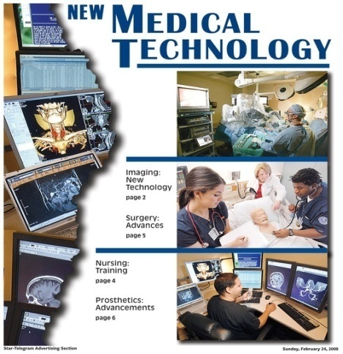

Kinds of technology
Technology on your hands
Instructional technology
Assistive technology
Medical technology
Technology productive tools
Information technology

Slide 8

Technology applications
In the professional field
Benefits of technology
Processes and technology
Objective: Show technology benefits
in the professional life.

Slide 9

Technology in the professional field
Technology applications
Simplifies the managed of data
Saves time in the processes
Helps in complicated calculation
Facilitates the tasks

Slide 10
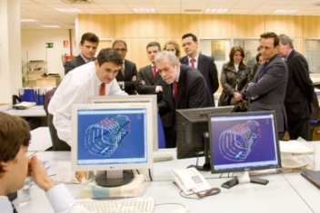
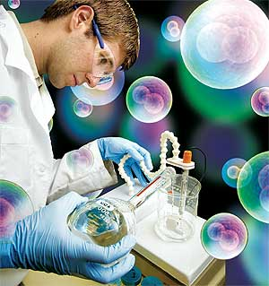


Technology Beneficiates Professionals
Technology applications
  Helps Engineers in their tasks
  Permits Scientifics be up dated
  Doctors can improve their works
  Facilitates the secretaries in their activities

Slide 11

Difference processes of some professions
Technology applications
Communication
Equipments and applications
Opportunities and facilities

Slide 12

Secretary Activities and technology
Secretary has functions
Secretaries must be trained
Equipments and software created to secretaries
  Objective: Presents the technology resources that helps secretary’s functions

Slide 13
The Secretary’s Functions
Secretary Activities and technology
Develops different activities
Works at many fields
Assists various clerical duties
Functions are divided into three parts
Communication, Organizational and Managerial

Slide 14

Training and qualifications of the secretary
Secretary Activities and technology
They Acquires and improves their skills in various ways:
  Education programs through agencies
  College degree
  Informal training
  Participating in Online education
  Self training

Slide 15
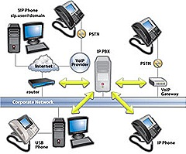
Equipments and software created to secretaries
Secretary Activities and technology
Equipments
    Computers (presentations, reports, etc)
    Fax Machines, telephone systems
    Photocopiers, scanners
Software
    Presentation Software
    Word processing software
    Mail Processing software
    Other Software (legacy systems)

Slide 16

Internet in the professional field
History
Concept and elements
Advantages and disadvantages
Objective: Demonstrates the benefits
of using Internet

Slide 17

History of Internet
Internet in the professional field
Launched in 1971
ARPANET known as the first network
Ray Tomlinson established the "@"
World-Wide Web was released by Tim Berners-Lee

Slide 18
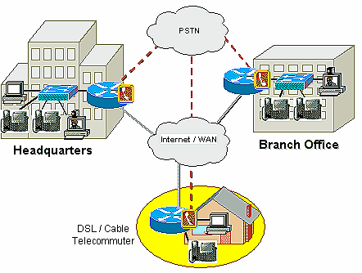
Concept and elements
Internet in the professional field
Interconnection of the variety of networks and computers.
Uses of a set of protocols
Permit to access to pages of information
There are two adaptations: Intranet, extranet.

Slide 19
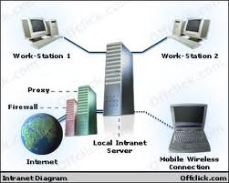
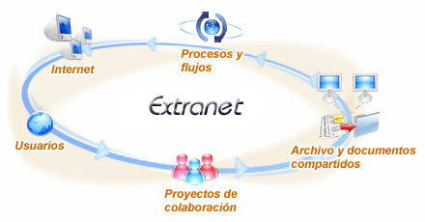
Intranet
Access information within company
Allows to access public internet through firewall servers
Extranet
It is extended to users outside the company
It can be expensive

Slide 20


Internet in the professional field
Advantages
Allow Communication
Share Information
Allow E-Commerce
Allow Out loading and Downloading Software
Disadvantages
Lost privacy
Spamming
Virus threat

Slide 21
Research report
Objective
To determine if companies have implemented new technologies.
Methods
An exploratory investigation was carried out in a qualitative and quantitative way.
Hypothesis
Professionals need technology to do their
jobs.

Slide 22
Research Report
Data collection
Qualitative findings
Technology has been created to ease the work of the professionals.
Employees have improved the development of their activities.
They use different software as SharePoint and Exchange.
He provided me a table where we could see,
how technology has been important
for the Municipality of Guayaquil.

Slide 23

Research Report
Qualitative findings
New High – Tech implementation | 2005 | 2008
Personals Computers | 1000 | 1460
Data link | 3 | 24
Guayaquil Portal | No | Yes
Internet | No | Yes
E-mail | No | Yes
SharePoint | No | Yes
Contingency Sites | No | Yes
Document scanning process | No | Yes

Slide 24

Quantitative findings
Research Report
I chose two public institutions:
  Commissary 6th of the Woman
  Municipality of Lomas de Sargentillo
We will see different questions with their statistics results.

Slide 25
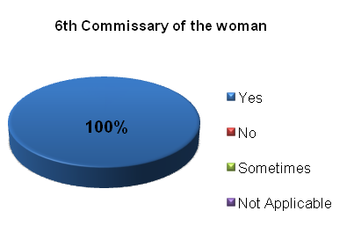
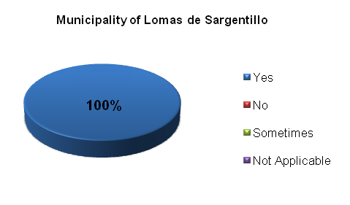
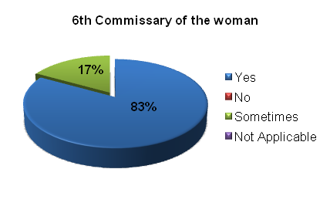
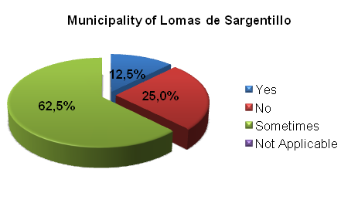
Quantitative findings
Research Report
Have technologies helped improve their job performance?
Are there applications which have been difficult at the moment to use them?

Slide 26
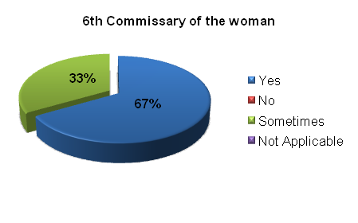
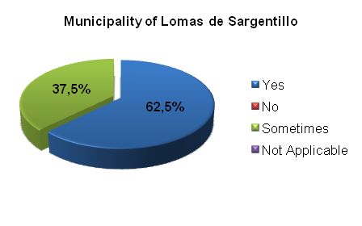
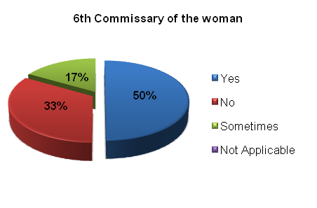
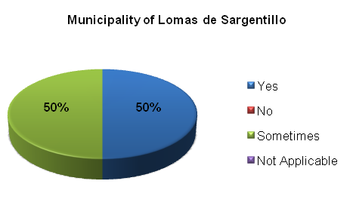
Research Report
Quantitative findings
Have new technological advances allowed saving more time in their tasks?
Do you think you should have new applications which help you in your work?

Slide 27
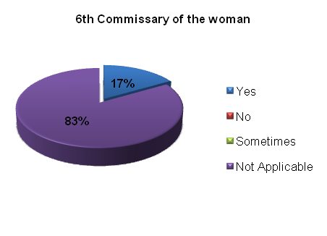
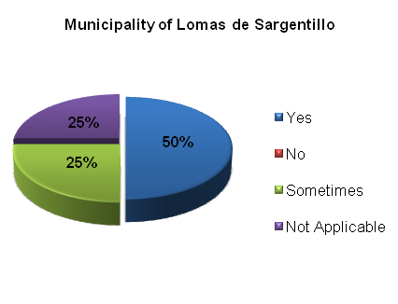
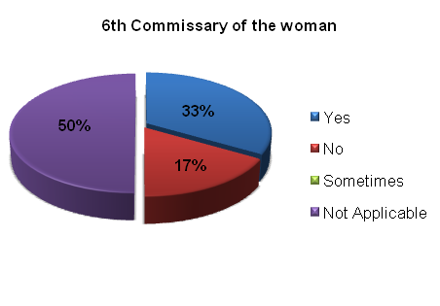
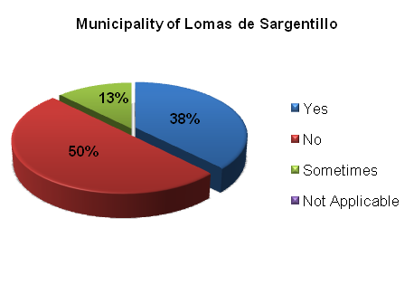
Research Report
Quantitative findings
The access, navigation and query of the Intranet are made in a quick and easy way, which allows obtaining appropriate information?
Do you know to whom to turn in order to request missing information or technical support in case of failure?

Slide 28
Conclusion
People are agree that technology is necessary.
Technology improve professional activities and companies productivity.
Professionals have to learn how to use technologies that are implemented at the office.
Business people know the benefits
of technology.

